Slide 1

Evesham Township Open Space Overview

Slide 2
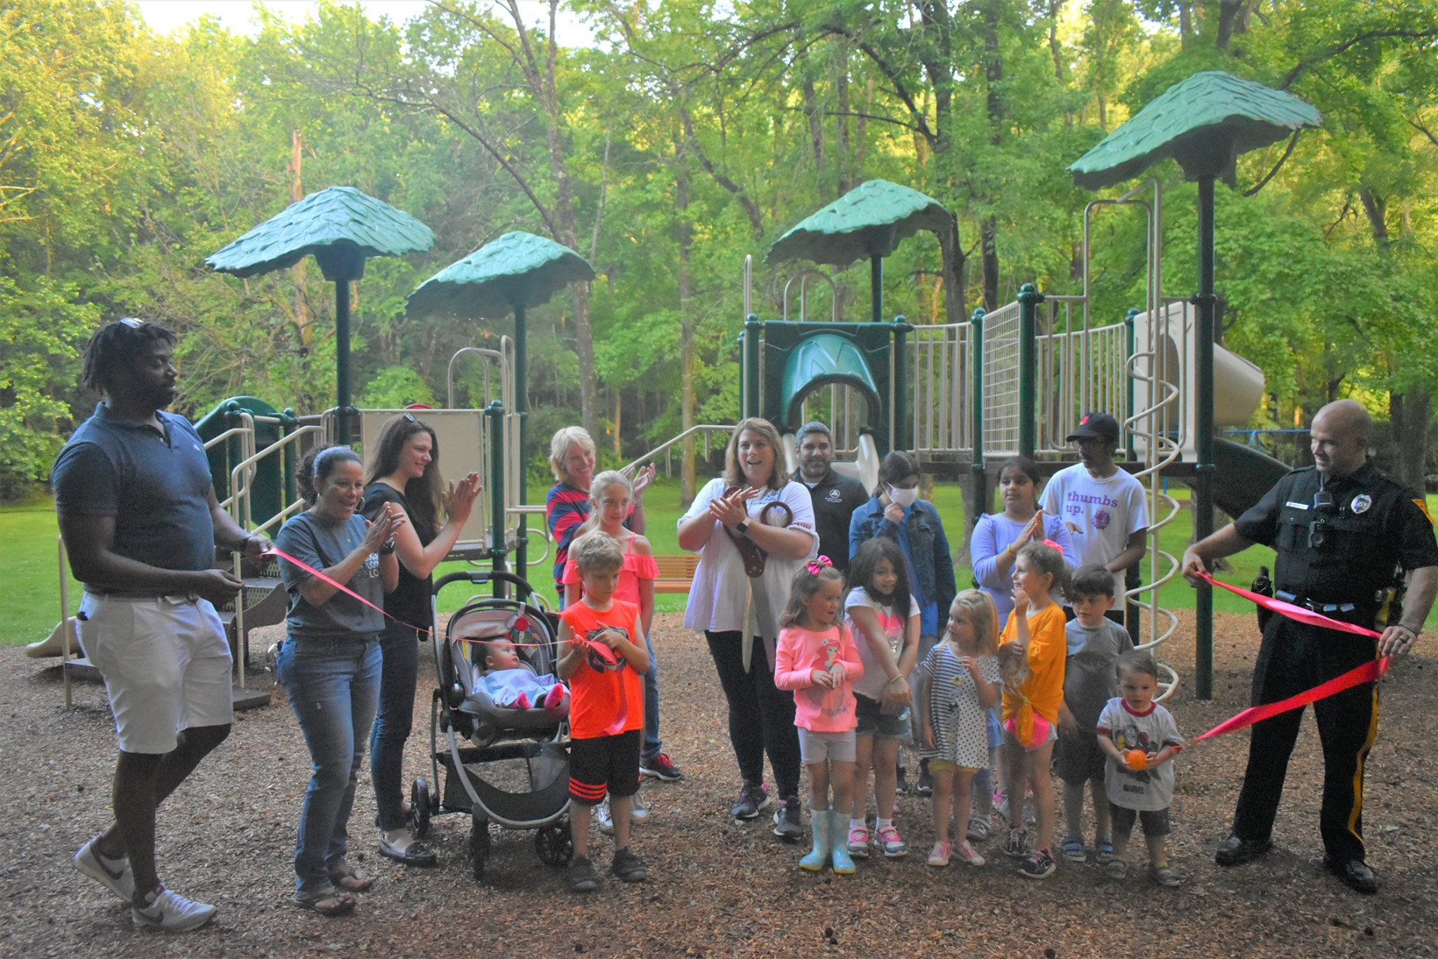
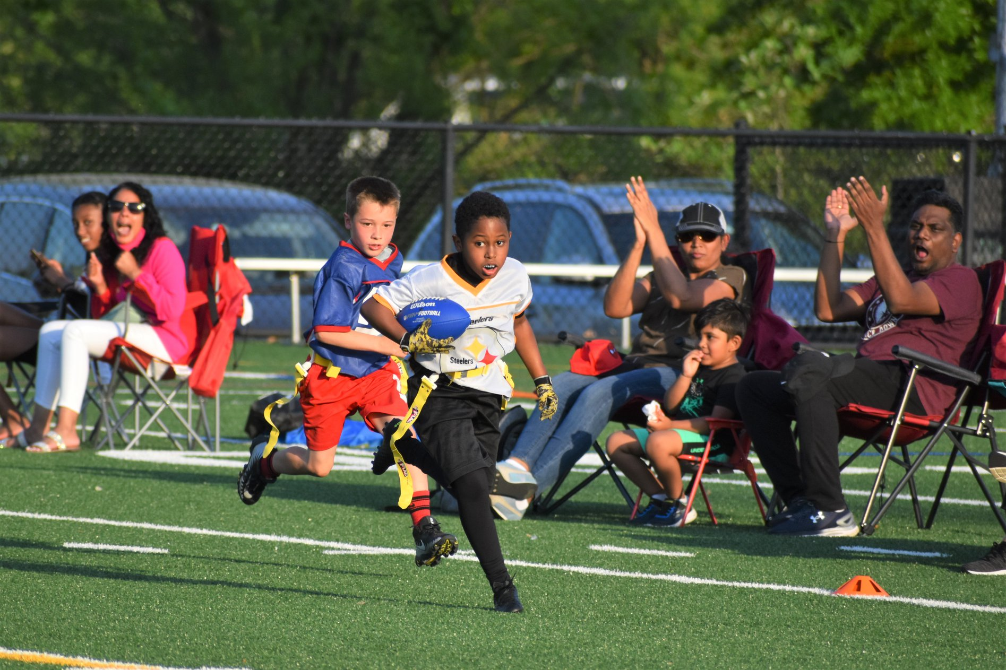
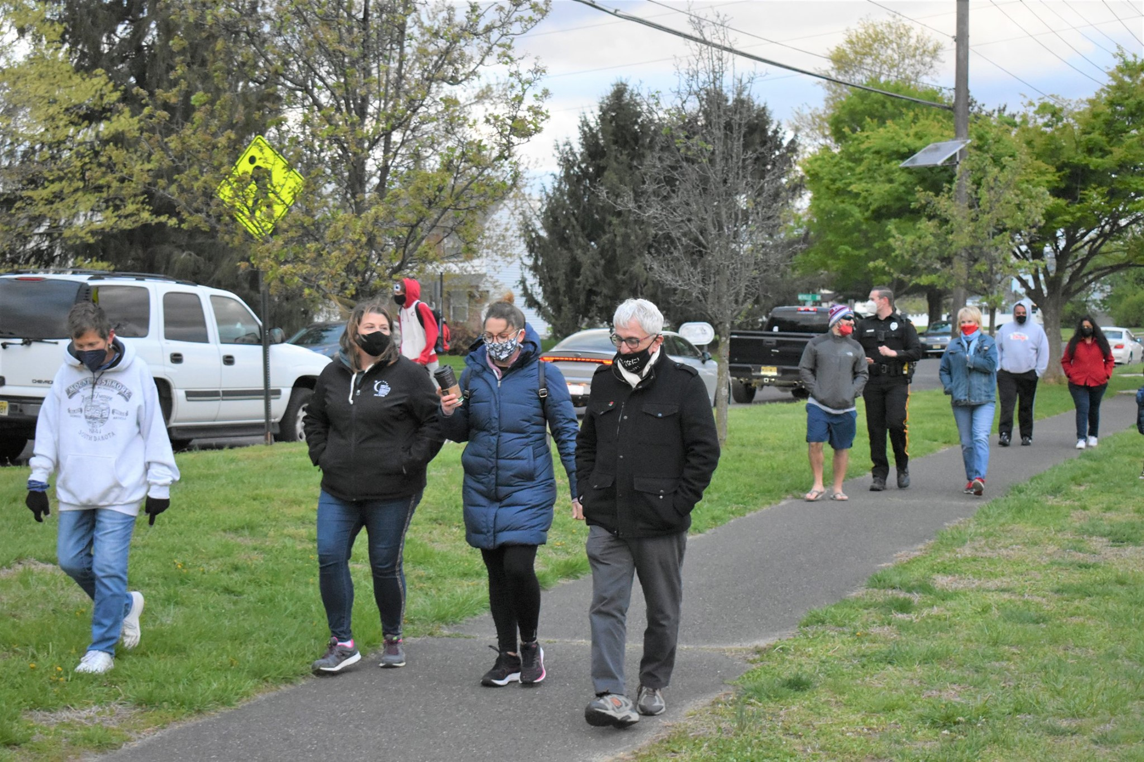
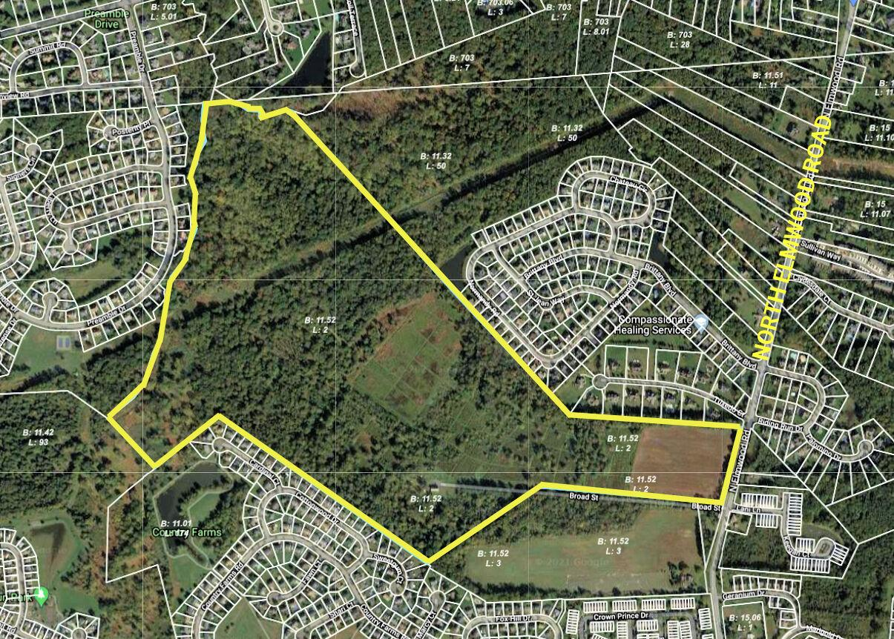
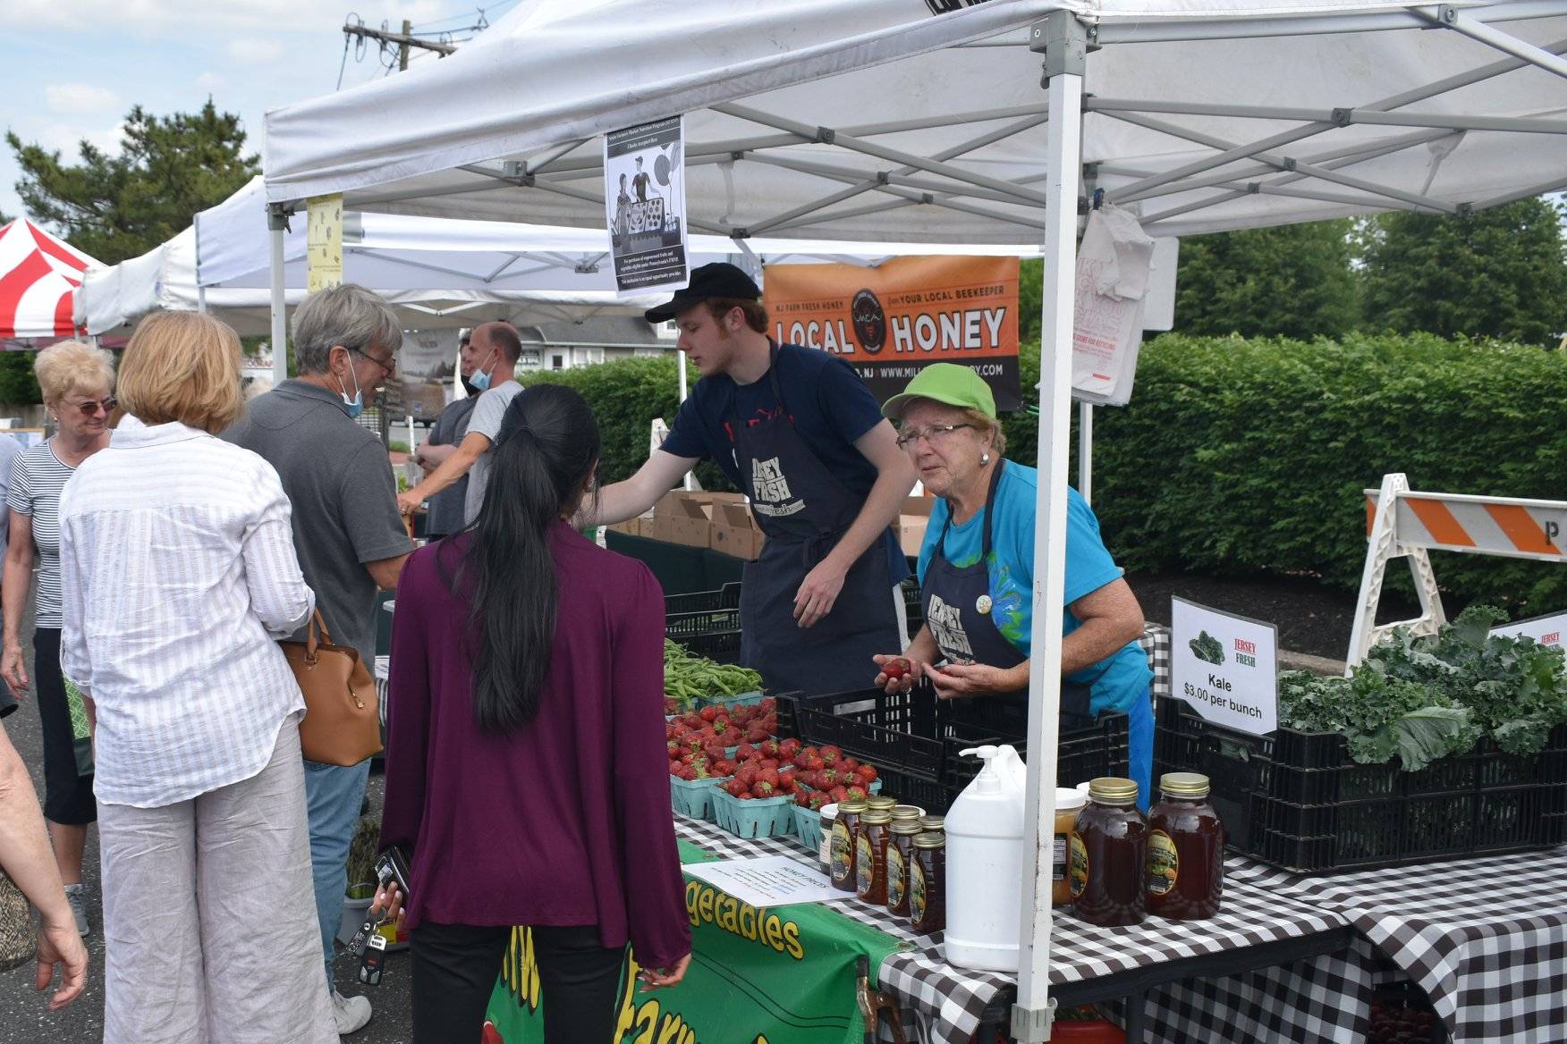
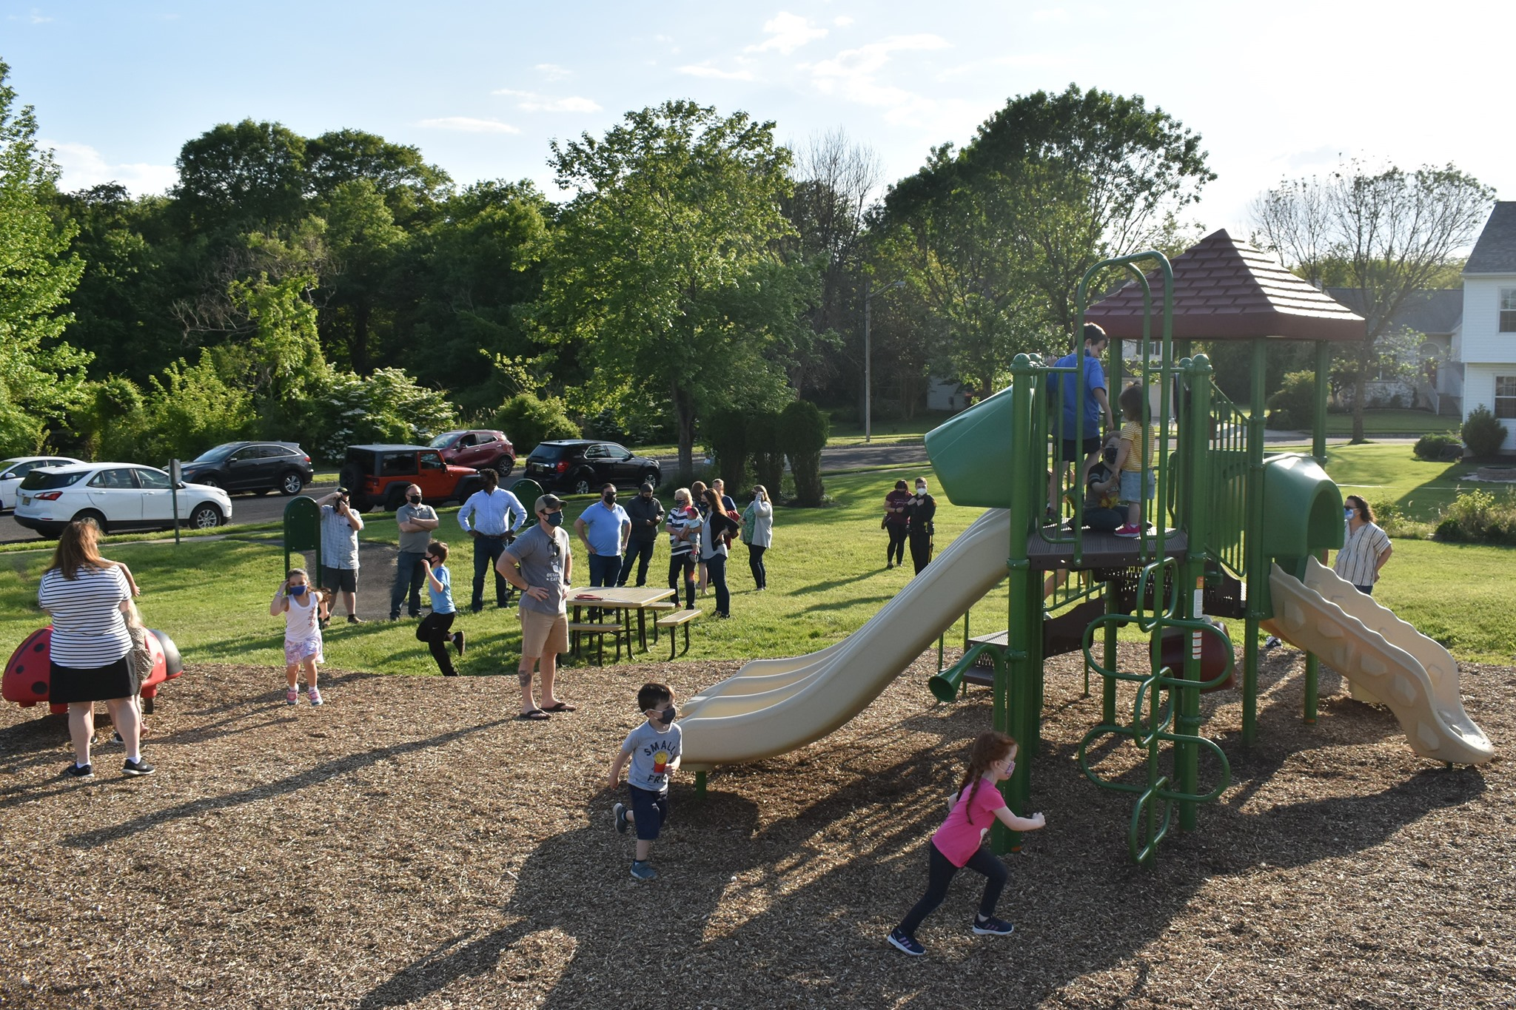
Open Space and Parks Improvements

Slide 3
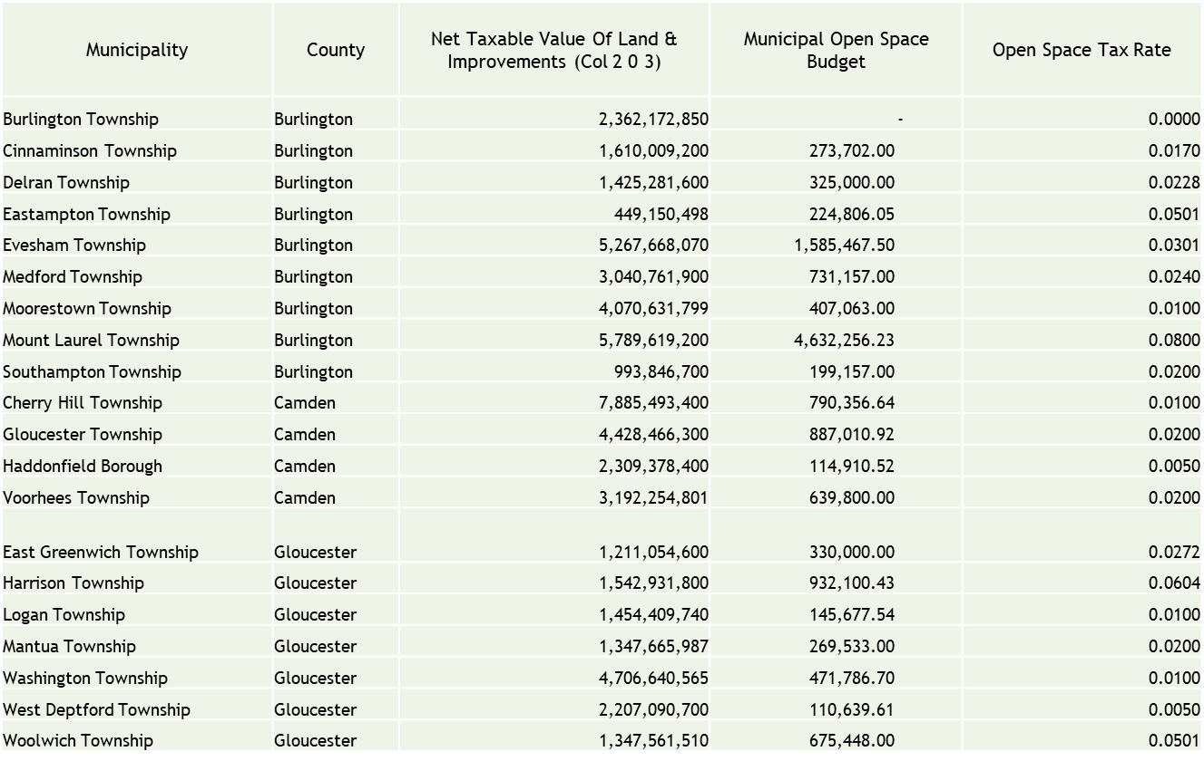
Eveham’s Current Open Space Tax Rate

Slide 4
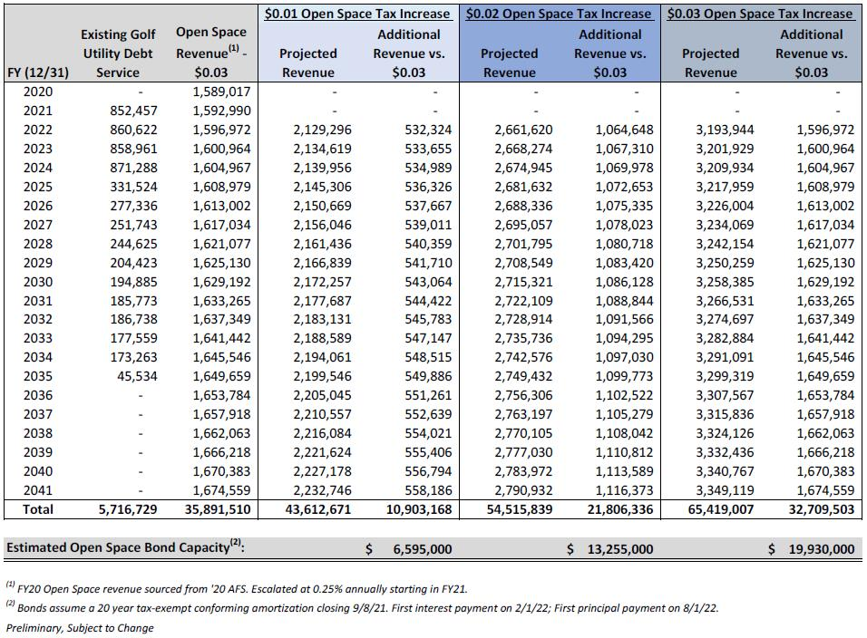
Evesham Township Open Space Projected Revenue Increases & Debt Service Capacity

Slide 5
Open Space Budget

Slide 6
Thank you

