Slide 1


Mayor Jaclyn Veasy
Evesham Township, NJ

Slide 2
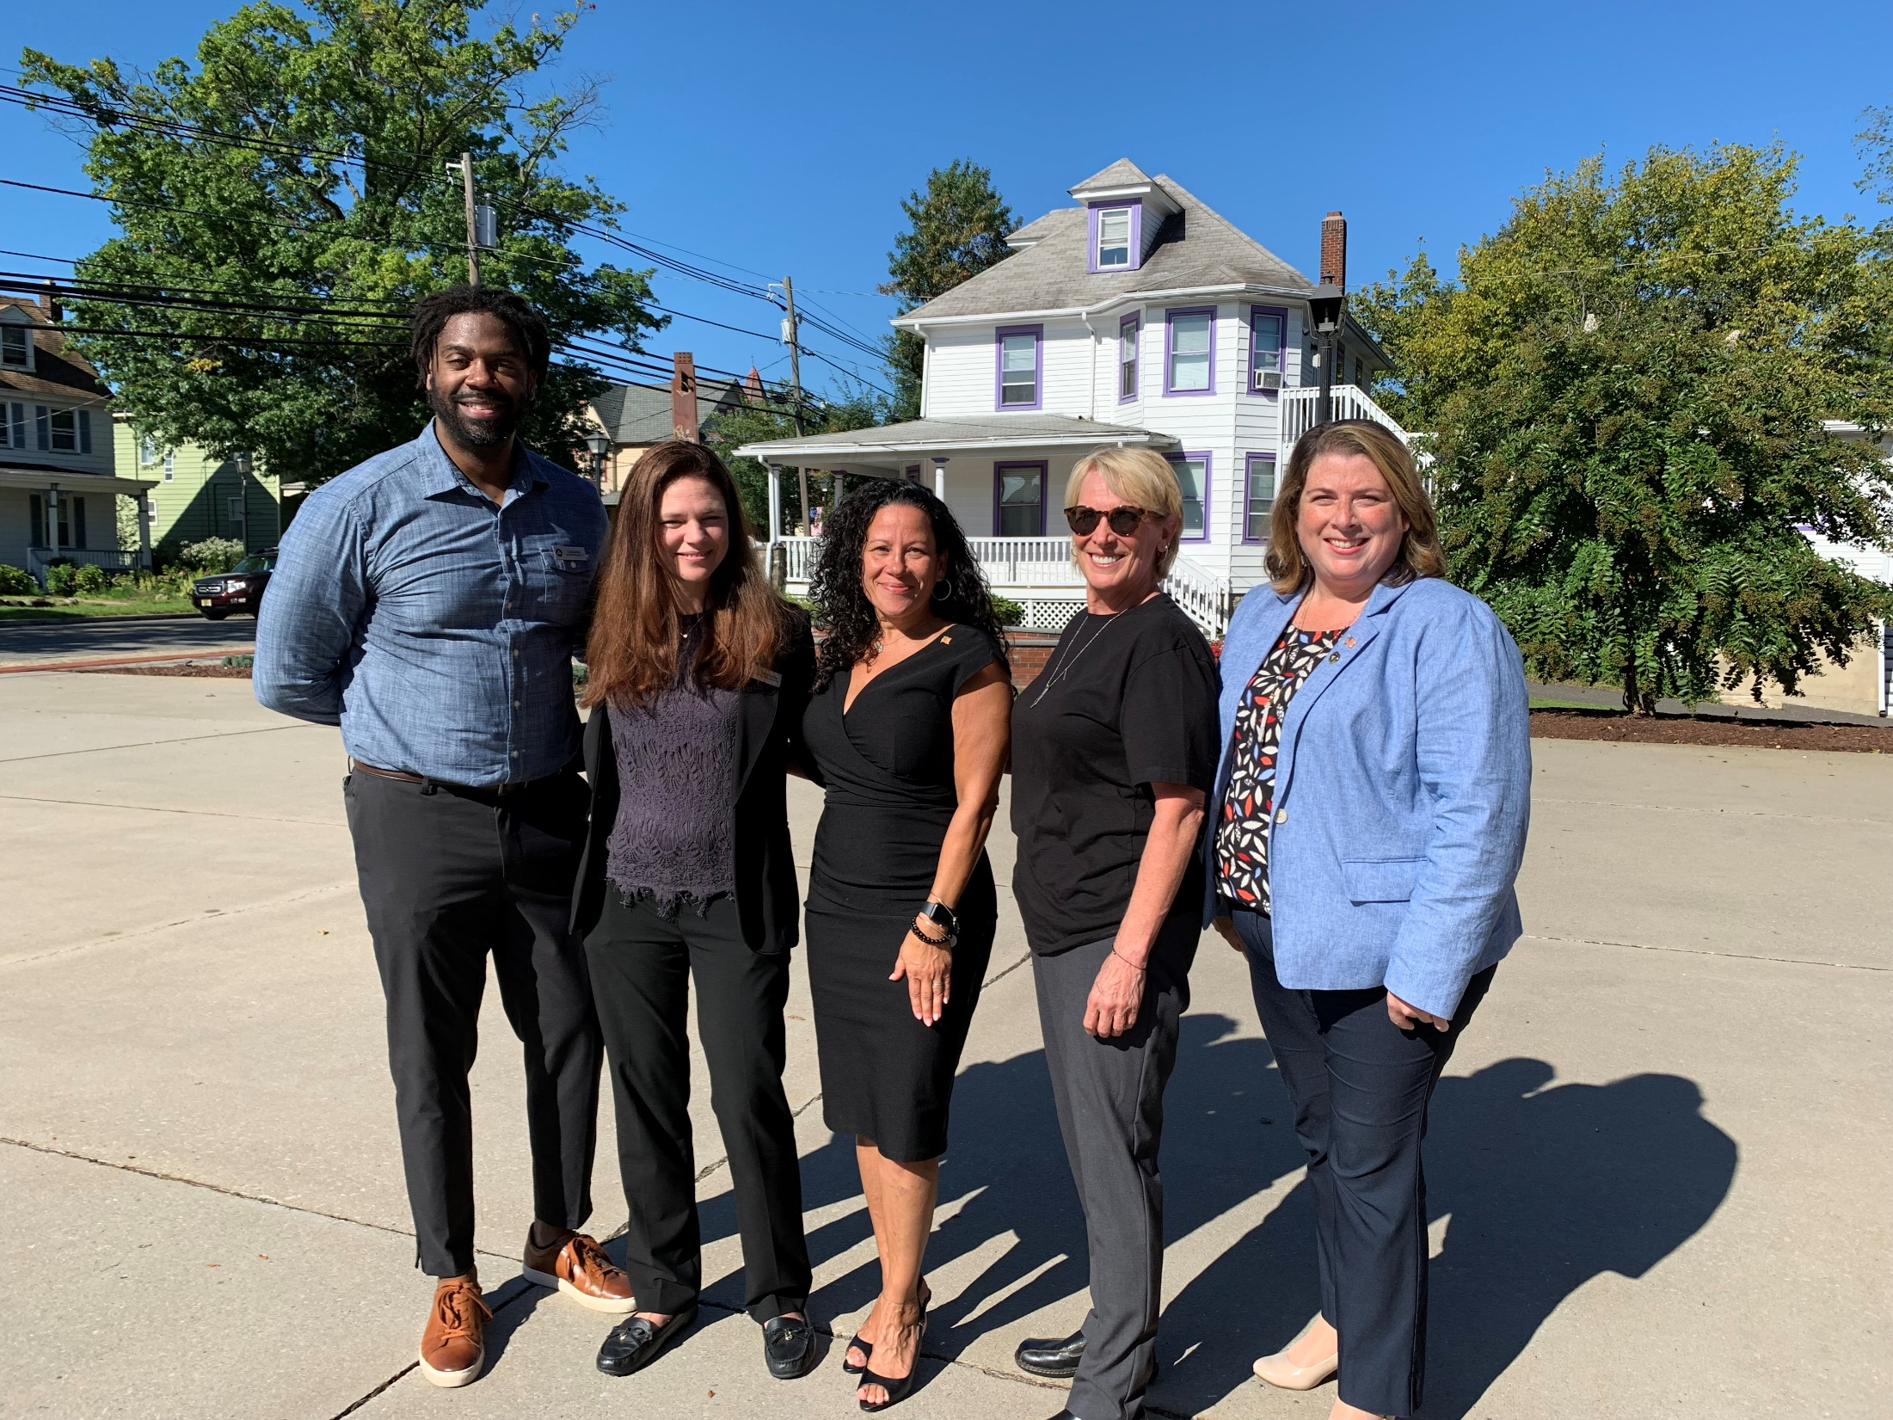
BEING A HEALTHY TOWN THROUGH A PANDEMIC
MAYOR’S WELLNESS COMMITTEE:
Mayor
Township Council
Township Management Team
- Department Leaders
Community Leadership Boards
- Senior Citizen Advisory Committee
- Veterans & Disability Advisory Committee
- Evesham Economic Advisory Council
- Human Rights Advisory Council
- Youth Advisory Committee
- Community Policing Unit
- Green Team
- Marlton Recreation Council
Notes:
The New Jersey Health Care Quality Institute is the only independent, nonpartisan advocate for health care quality in New Jersey. We believe health care should be safe and of high quality, accessible, affordable, equitable, and transparent – and in order to improve health care, we believe collaboration is essential. At the Quality Institute, we bring together more than 100 unique member organizations all committed to helping us achieve our mission.

Slide 3
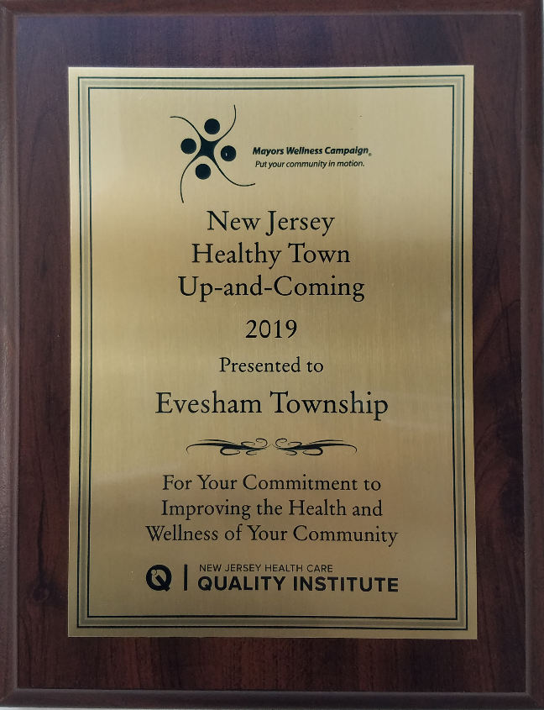
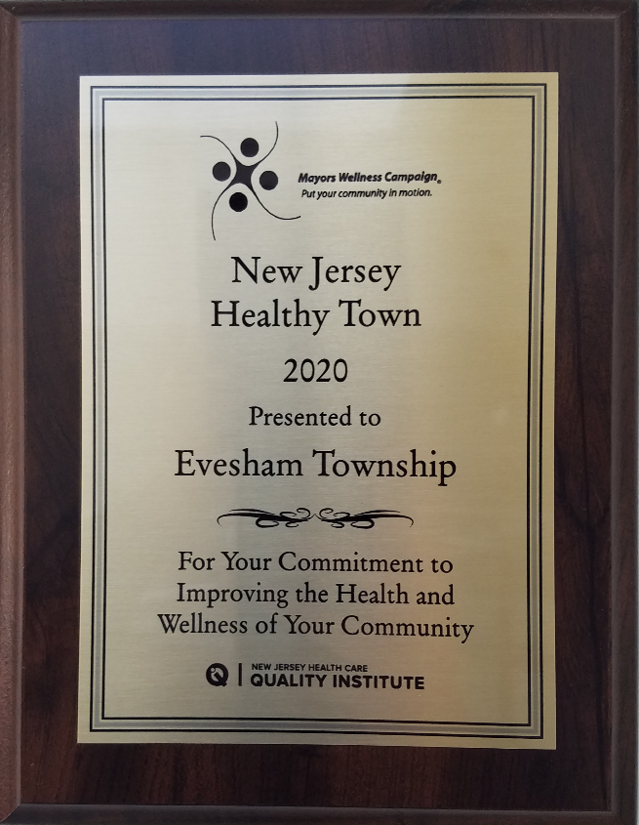
BEING A HEALTHY TOWN THROUGH A PANDEMIC
The Evesham Mayor’s Wellness Campaign focused not only on creating new programs for residents in response to the pandemic, but also worked on trying to make the Township’s current programs more accessible and safe during the pandemic.
2019: HEALTHY TOWN UP & COMING
2020: HEALTHY TOWN
Notes:
The New Jersey Health Care Quality Institute is the only independent, nonpartisan advocate for health care quality in New Jersey. We believe health care should be safe and of high quality, accessible, affordable, equitable, and transparent – and in order to improve health care, we believe collaboration is essential. At the Quality Institute, we bring together more than 100 unique member organizations all committed to helping us achieve our mission.

Slide 4
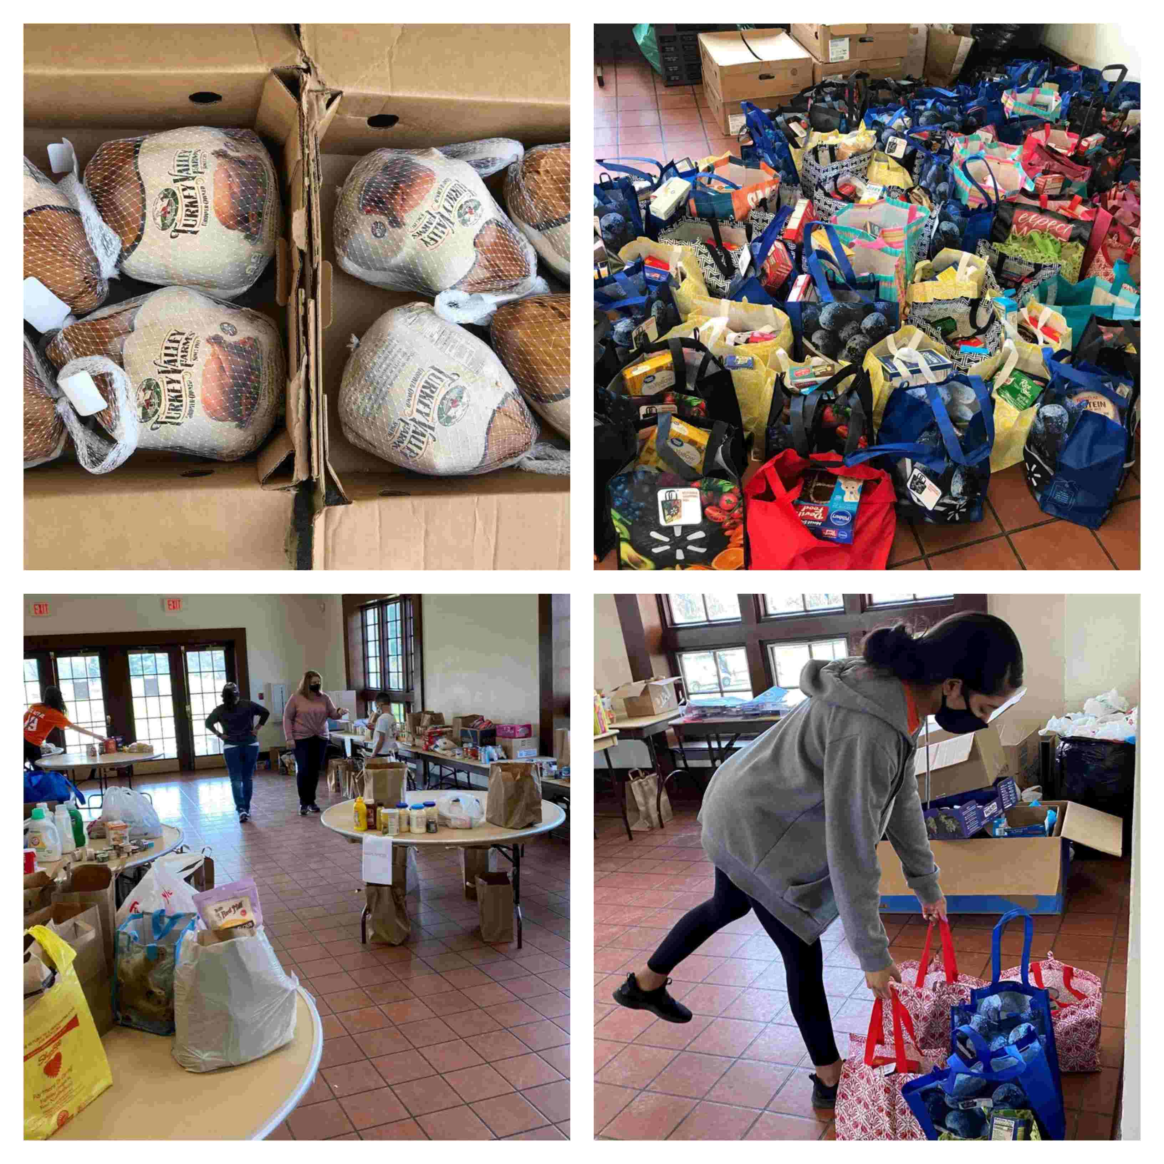
BEING A HEALTHY TOWN THROUGH A PANDEMIC
PROGRAMS OFFERED DURING 2020:
Office of Emergency Management (OEM)
- Maintained a 24/7 Help
& Volunteer Hotline
- Free COVID Testing
- Food pantry
- Blood drive
- Holiday Packages
- Utilized transportation service to bring
meals & bags of non-perishable foods to
residents in need
- Webinars geared towards safety
protocols
Notes:
The New Jersey Health Care Quality Institute is the only independent, nonpartisan advocate for health care quality in New Jersey. We believe health care should be safe and of high quality, accessible, affordable, equitable, and transparent – and in order to improve health care, we believe collaboration is essential. At the Quality Institute, we bring together more than 100 unique member organizations all committed to helping us achieve our mission.

Slide 5

BEING A HEALTHY TOWN THROUGH A PANDEMIC
PROGRAMS OFFERED DURING 2020:
Outdoor Recreation
- Walk with the Mayor
- Summer Camp
- Yoga in the Park
- Black Run Preserve
- MRC Sports Unity Program
- Golf & Driving Range
- Parks/Playgrounds/Athletic Fields
Notes:
The New Jersey Health Care Quality Institute is the only independent, nonpartisan advocate for health care quality in New Jersey. We believe health care should be safe and of high quality, accessible, affordable, equitable, and transparent – and in order to improve health care, we believe collaboration is essential. At the Quality Institute, we bring together more than 100 unique member organizations all committed to helping us achieve our mission.

Slide 6
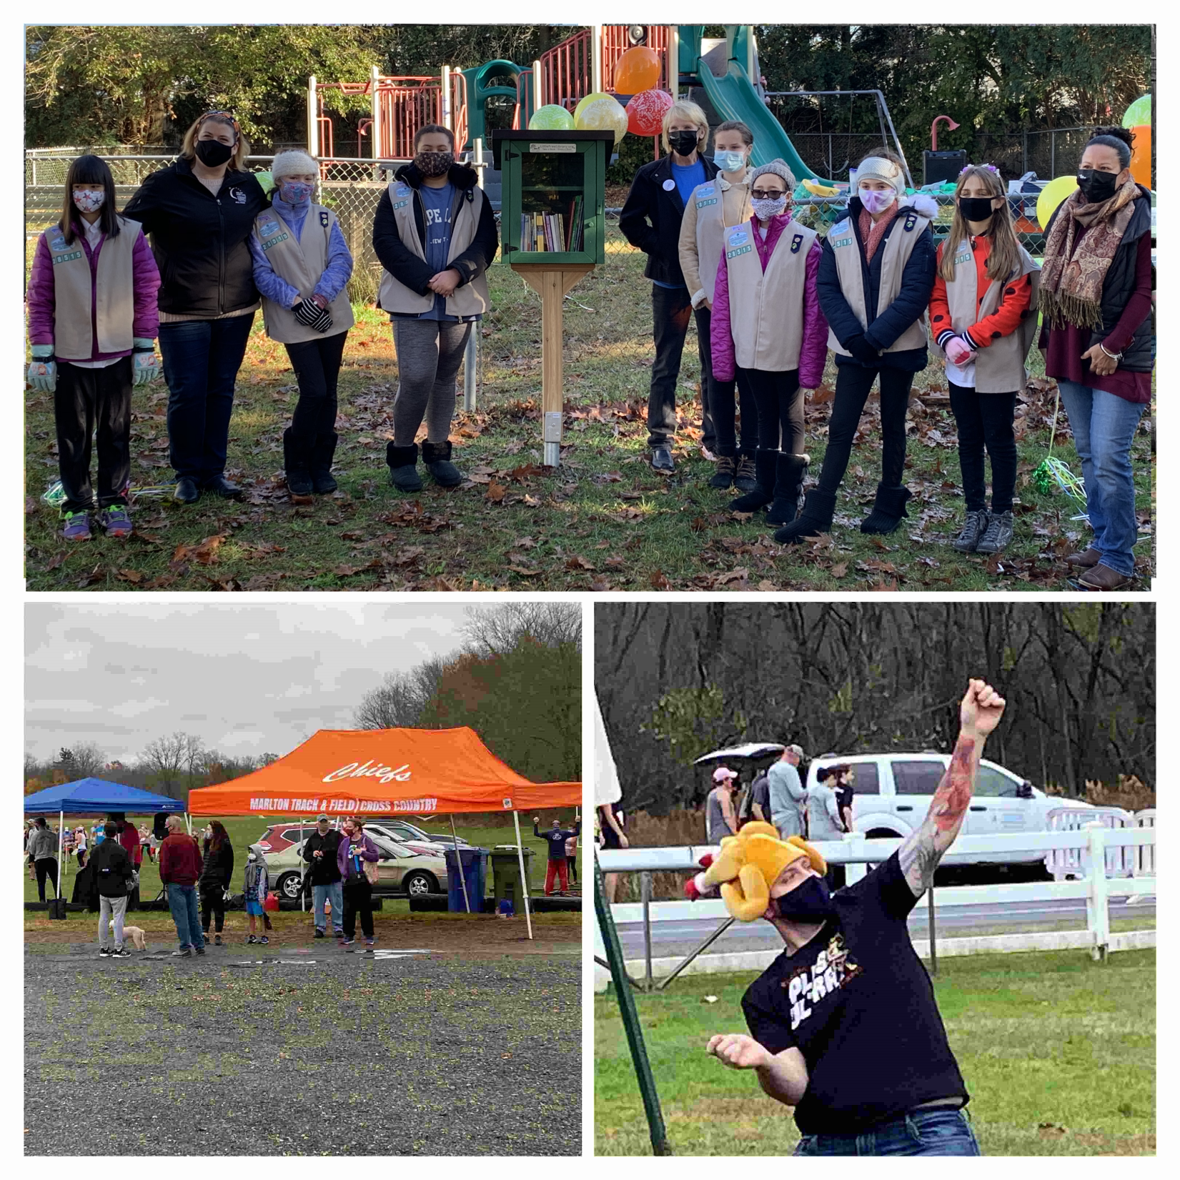
BEING A HEALTHY TOWN THROUGH A PANDEMIC
PROGRAMS OFFERED DURING 2020:
Community Events
- Farmer’s Market
- Drive-In Movie Nights
- Turkey Trot 5k
- Community Clean-Ups
- Planting Wildflower Patches with
Native Plants
- Little Free Libraries
Notes:
The New Jersey Health Care Quality Institute is the only independent, nonpartisan advocate for health care quality in New Jersey. We believe health care should be safe and of high quality, accessible, affordable, equitable, and transparent – and in order to improve health care, we believe collaboration is essential. At the Quality Institute, we bring together more than 100 unique member organizations all committed to helping us achieve our mission.

Slide 7
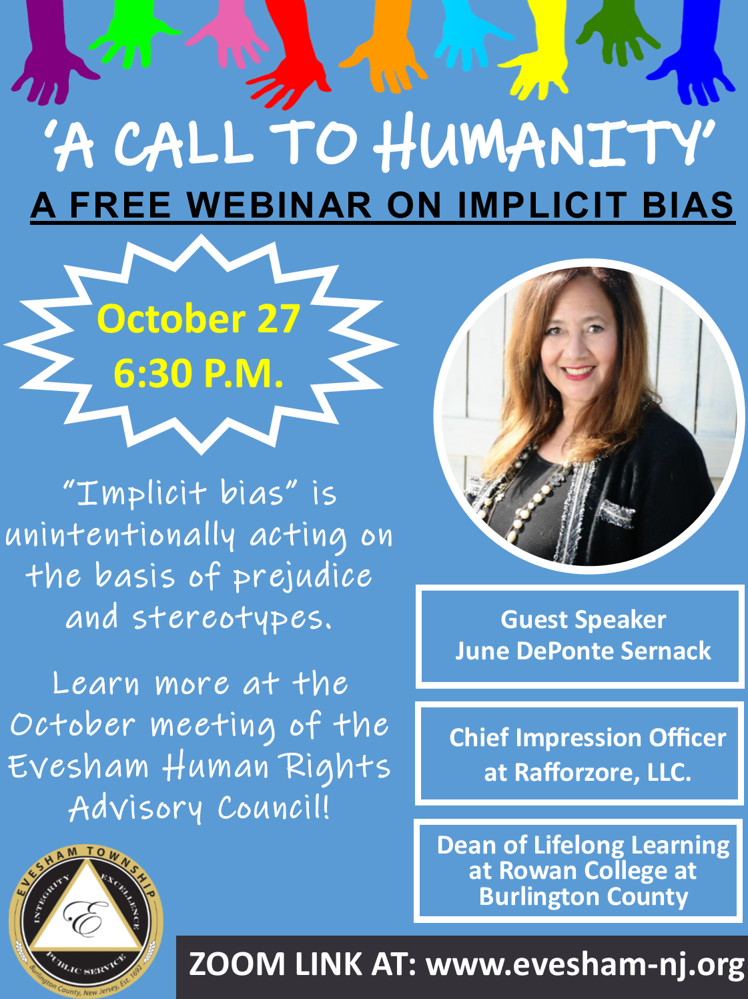
BEING A HEALTHY TOWN THROUGH A PANDEMIC
PROGRAMS OFFERED DURING 2020:
Seminars & Workshops
(Virtual & In-Person)
- Implicit Bias
- Coping with Stress during Pandemic
- Sustainable Jersey Programs
- Safe Reopening for Businesses
- SNAP Activities
- Ombudsman for Individuals with
Intellectual or Developmental
Disabilities
Notes:
The New Jersey Health Care Quality Institute is the only independent, nonpartisan advocate for health care quality in New Jersey. We believe health care should be safe and of high quality, accessible, affordable, equitable, and transparent – and in order to improve health care, we believe collaboration is essential. At the Quality Institute, we bring together more than 100 unique member organizations all committed to helping us achieve our mission.

Slide 8
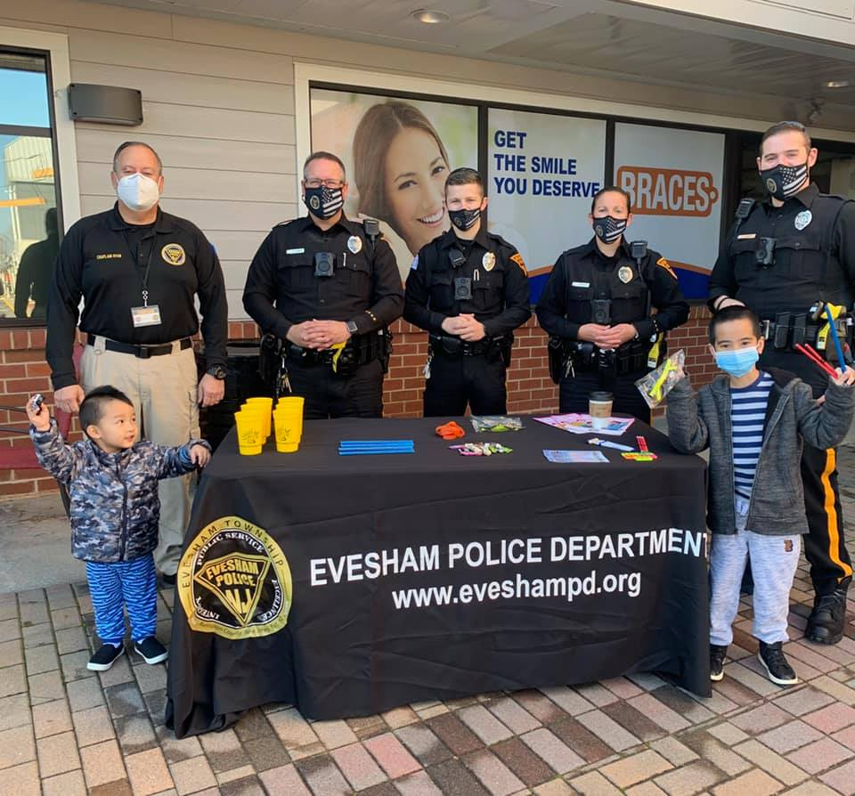
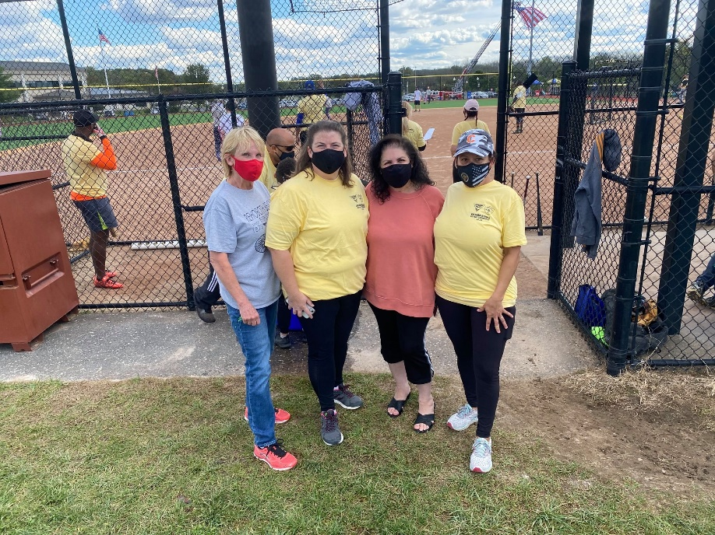
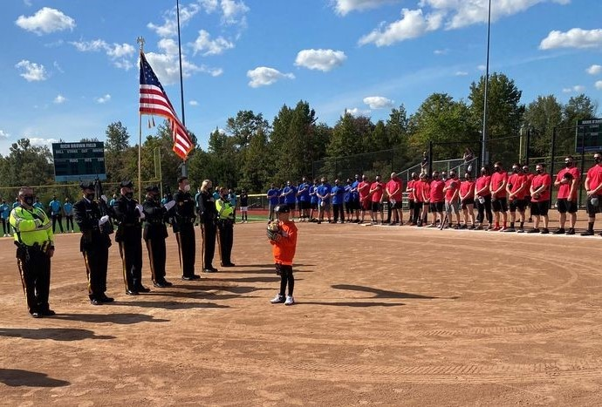
BEING A HEALTHY TOWN THROUGH A PANDEMIC
PROGRAMS OFFERED DURING 2020:
Community Policing Unit
- “Coffee with a Cop”
- Boot Camps
- Drive-Thru Trunk or Treat
- Fallen Heroes Tournament
- Children’s Bike Rodeos
- “Shop with a Cop”
Notes:
The New Jersey Health Care Quality Institute is the only independent, nonpartisan advocate for health care quality in New Jersey. We believe health care should be safe and of high quality, accessible, affordable, equitable, and transparent – and in order to improve health care, we believe collaboration is essential. At the Quality Institute, we bring together more than 100 unique member organizations all committed to helping us achieve our mission.

Slide 9

CONTINUING WELLNESS IN EVESHAM TOWNSHIP
In 2021, Evesham Township continued efforts we started in 2020, including evaluating and expanding our programs in order to meet the needs of the residents of our community.
We strive to challenge our Mayor’s Wellness Committee to think outside the box in order to make sure overall wellness is our top priority.
Our mission is, and will continue as such, to be an inclusive and healthy community for all residents.
Notes:
The New Jersey Health Care Quality Institute is the only independent, nonpartisan advocate for health care quality in New Jersey. We believe health care should be safe and of high quality, accessible, affordable, equitable, and transparent – and in order to improve health care, we believe collaboration is essential. At the Quality Institute, we bring together more than 100 unique member organizations all committed to helping us achieve our mission.

